Slide 1

COMMUNICATIONS SKILLS

Slide 2
Good Communication
The ability to communicate effectively with superiors, colleagues and staff is essential.
Workers in the digital age must know how to effectively convey and receive messages in person as well as via phone, email and social media.
Good communication skills will help you get hired, land promotions and be a SUCCESS throughout your career.

Slide 3

Top 10 Communication Skills

Slide 4
Want to stand out from the competition?
These are the top 10 communication skills that recruiters and the hiring managers want to see on your resume and cover letter.
Highlight these skills and demonstrate them during job interviews, and you will make a solid first impression.
CONTINUE to develop these skills once you’re hired, and you will impress your boss, teammates and clients.

Slide 5
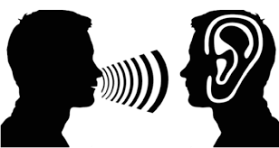
1- Listening
Being a good listener is one of the best ways to be a good communicator.
No one likes to communicate with someone who only cares about putting in his/her words and does not take the time to listen to the other person.
If you’re not a good listener, its going to be hard to comprehend what you’re being asked to do.
TAKE THE TIME TO PRACTICE ACTIVE LISTENING.
Paying close attention
Ask clarifying questions
Rephrasing

Slide 6
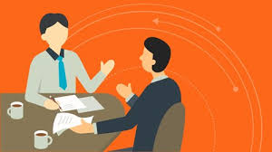
2- Non-Verbal Communication
Your body language, eye contact, hand gestures and tone of voice all color the message you’re trying to convey.
A relaxed, open stance (arms open, legs relaxed),and a friendly tone will make you appear approachable and will encourage others to speak openly with you.
Eye contact is also important; you want to look the person in the eye to demonstrate that you’re focused on the person and the conversation. ( be sure not to stare)
Pay attention to people’s non verbal signals. e.g., if a person is not looking in the eye, he or she might be uncomfortable or hiding the truth.

Slide 7

3-Clarity and Concision
Good verbal communication means saying just enough-don’t talk too much or too little.
Try to convey your message in as few words as possible.
Say what you want clearly and directly, whether you’re speaking to someone in person, on the phone, or via Email.
If you RAMBLE on, your listener will either tune you out or will be unsure of exactly what you want.

Slide 8
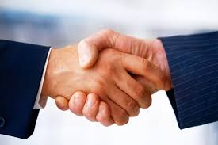
4-Friendliness
Through a friendly tone, a personal question, or simply a smile, you will encourage your coworkers to engage in open and honest communication with you.
Its important to be nice and polite in all your workplace communications. i.e. face-to-face and written.
When you can, personalize your emails to coworkers/or employees- a quick “I hope you all had a good weekend” at the start of an email can personalize a message and make the recipient feel more appreciated.

Slide 9

5- Confidence
It is important to be confident in your interactions with others.
Confidence shows your coworkers that you believe in what you’re saying and will follow through.
Exuding confidence can be as simple as making eye contact or using a firm but friendly tone.
AVOID making statements sound like questions. Of course, be careful not to sound arrogant or aggressive.
Be SURE that you are always listening to others.

Slide 10

6- Empathy
Using phrases as simple as “I understand where you are coming from” demonstrate that you have been listening to the other person and respect their opinions.
IMPORTANT: Even when you DISAGREE with an employer, coworker or an employee, it is important for you to understand and respect their point of view.

Slide 11
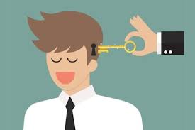
7- Open-mindedness
A good communicator should enter into any conversation with a flexible, open mind.
Be open to listening and understanding the other person’s point of view, rather than simply getting your message across.
By being willing to enter into a dialogue, even with people with whom you disagree, you will be able to have more honest, productive conversations.

Slide 12
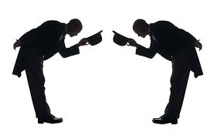
8- Respect
People will be more open to communicating with you if you convey respect for them and their ideas.
Simple actions like using a person's name, making eye contact, and actively listening when a person speaks make the person feel appreciated.
On the phone, avoid distractions and stay focused on the conversation.
Convey respect through Email by taking the time to edit your message. If you send a sloppily written, confusing email, the recipient will think that you do not respect his/her enough to think through you communication.

Slide 13

9- Feedback
Being able to appropriately give and receive feedback is an important communication skill.
Managers and supervisors should continuously look for ways to provide employees with constructive feedback, be it through email, phone calls, or weekly status updates.
GIVING FEEDBACK involves giving praise as well-something as simple as saying “good job” or “thanks for taking care of that” to an employee can greatly increase motivation.
RECEIVING FEEDBACK involves careful listening, ask clarifying questions and making efforts to implement the feedback.

Slide 14

10- Picking The Right Medium
An important communication skill is to simply know what form of communication to use. e.g. some serious conversations (layoffs, resignations, changes in salary, etc.) are almost best done in person.
You should also think about the person with whom you wish to speak, if they are a very busy person (such as your boss) you might want to convey your message through email.
People will appreciate your thoughtful means of communication and will be more likely to respond positively to you.

